Slide 1

Capstone Project
Classification of fake job and real job postings

Slide 2
Problem Statement:
We are living in unprecedented times due to COVID-19 pandemic hurting economies in every continent. Unemployment rates are increasing every single day with the United States(US) reporting around 42 million people applied for unemployment benefits, which is the highest recorded in its long history, millions have been furloughed in the United Kingdom, and thousands have been laid off around the world.
In the US, scammers uses the job listing to get job seekers to provide personal information, including their Social Security number, credit card information, and bank account information. These information is then used to access your bank account or your credit cards and to steal your identity.

Slide 3
objective
Help online job portals to filter out the scam job posts
Help prevent people seeking jobs from losing their money
Help relevant authorities to identify and clamp down on the scammers’ activities

Slide 4

DAtaset
The Employment Scam Aegean Dataset (EMSCAD) is a publicly available dataset containing 17,880 real-life job ads that aims at providing a clear picture of the Employment Scam problem to the research community and can act as a valuable testbed for scientists working on the field. The first publication is available online by MDPI Future Internet Journal.
EMSCAD records were manually annotated and classified into two categories. More specifically, the dataset contains 17,014 legitimate and 866 fraudulent job ads published between 2012 to 2014.

Slide 5
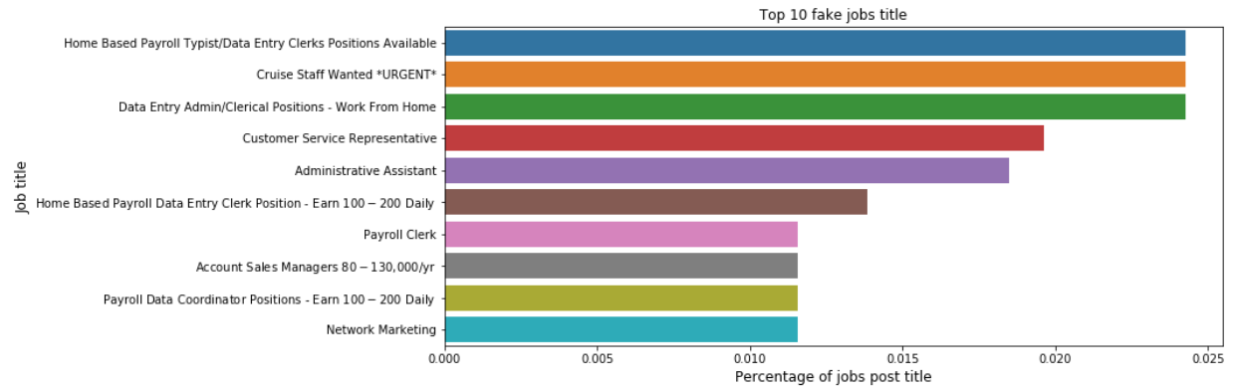
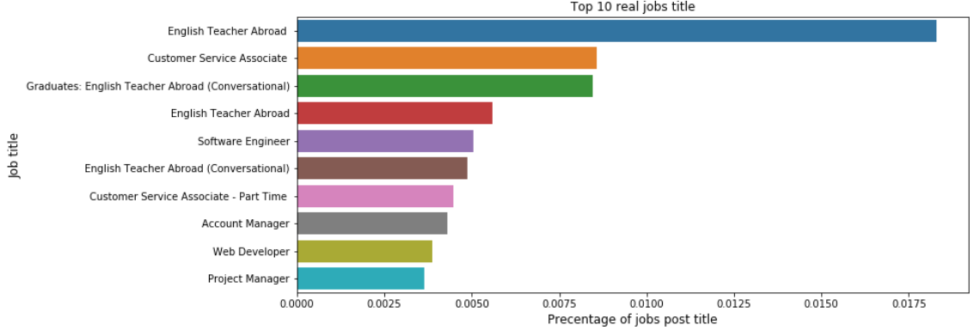
Exploratory data analysis
We can see that the scammers are targetting home-based and data entry positions.
Furthermore, fake job titles seem to put the amount of wage you can earn as compared to real job titles.

Slide 6
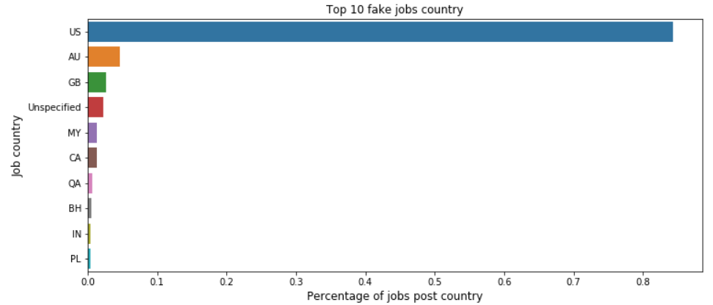
Exploratory data analysis
We can see that the 90% of the fake job posts are targeting the United States of America.

Slide 7
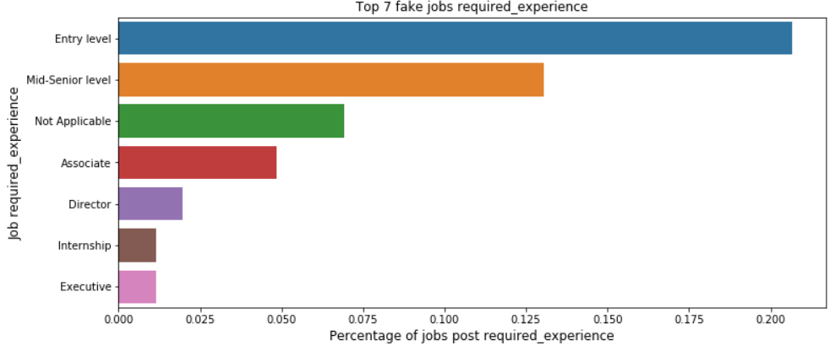
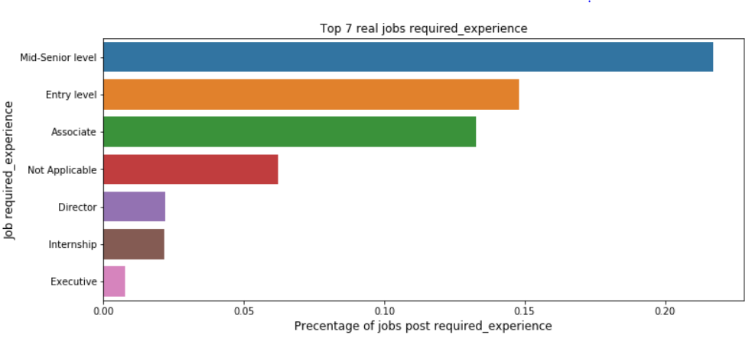
Exploratory data analysis
We can see that the entry level jobs are being targeted by scammer as compare to the real job market which is looking for mid-senior level positions

Slide 8
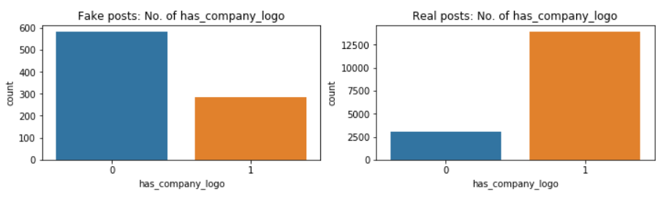
Exploratory data analysis
It seems that most fake job posts do not put the company logo as compared to real job posts.

Slide 9
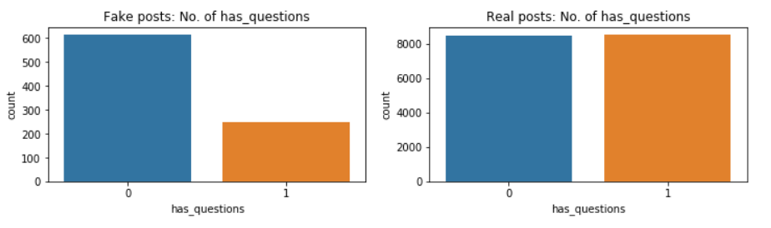
Exploratory data analysis
There is about a 65-35 split on fake job posts posting screening questions as compared to real job posts having a 50-50 split.

Slide 10
Feature engineering
Word features :–
'title', 'company_profile', 'description', 'requirements' and 'benefits’
Non-word features :–
'department', 'employment_type', 'required_experience', 'required_education', 'industry','function', 'country', 'state', 'city’, ‘min_salary’, ‘max_salary’, ‘telecomuting’, ‘has_company_logo’ and ‘has_questions’

Slide 11
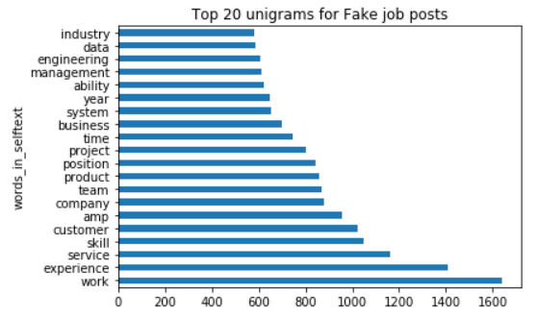
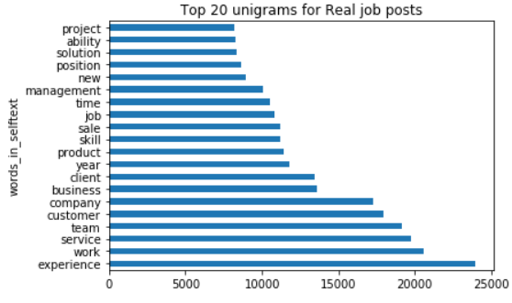
UNIGRAMS
We will combine columns for 'title', 'company_profile', 'description', 'requirements' and 'benefits’ to create my word features.

Slide 12
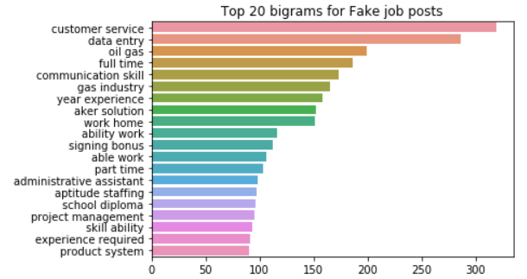
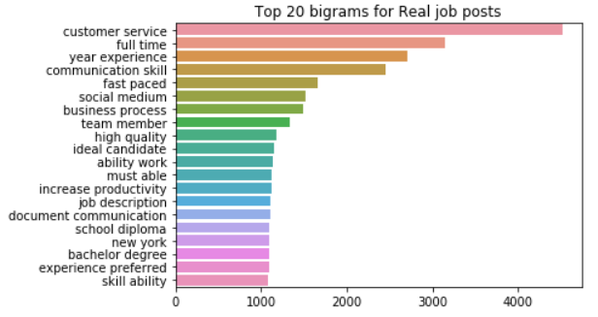
BIGRAMS
We can see data entry, oil gas, gas industry, work home are some key identifiers
High oil prices between 2012-2014 causing a demand for oil & gas jobs

Slide 13
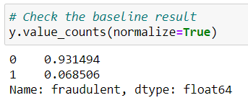
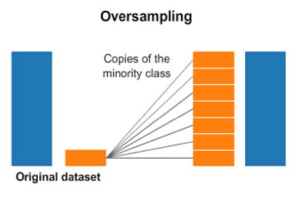
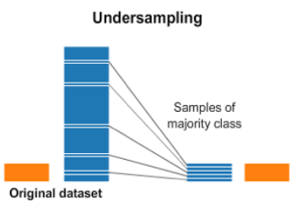
Imbalance class
We have an imbalance class. I will apply oversampling and undersampling techniques. First, I will oversample the minority class with Synthetic Minority Oversampling TEchnique (SMOTE) to about a 1:10 ratio, then undersample the majority class to achieve about a 1:2 ratio.
Nitesh Chawla, et al. in their 2002 research paper named for the technique titled “SMOTE: Synthetic Minority Over-sampling Technique.”
Notes:
SMOTE works by selecting examples that are close in the feature space, drawing a line between the examples in the feature space and drawing a new sample at a point along that line.
Specifically, a random example from the minority class is first chosen. Then k of the nearest neighbors for that example are found (typically k=5). A randomly selected neighbor is chosen and a synthetic example is created at a randomly selected point between the two examples in feature space.

Slide 14
Voting classifier
FRAUDr
VOTING CLASSIFIER
FRAUDr
NOT FRAUDr
FRAUDr
TFIDF + NAIVES BAYES MODEL
TFIDF + LOGISTIC REGRESSION MODEL
LOGISTIC REGRESSION MODEL

Slide 15
Conclusion

